Slide 1





Support Vector Machine
Devansh Awasthi (ENG17CS0065)
Deepak Purohit (ENG17CS0062)
BVM Anirudh (ENG17CS0048)
Dhruva Santosh (ENG17CS0070)

Slide 2
Introduction
Support Vector Machine (SVM) is a supervised machine learning algorithm which can be used for both classification or regression challenges. However, it is mostly used in classification problems.
The objective of the support vector machine algorithm is to find a hyperplane in an N-dimensional space(N — the number of features) that distinctly classifies the data points.
Our objective is to find a plane that has the maximum margin, i.e the maximum distance between data points of both classes. Maximizing the margin distance provides some reinforcement so that future data points can be classified with more confidence.

Slide 3
How Does SVM Work
The basics of Support Vector Machines and how it works are best understood with a simple example. Let’s imagine we have two tags: red and blue, and our data has two features: x and y. We want a classifier that, given a pair of (x,y) coordinates, outputs if it’s either red _or _blue. We plot our already labeled training data on a plane:

Slide 4
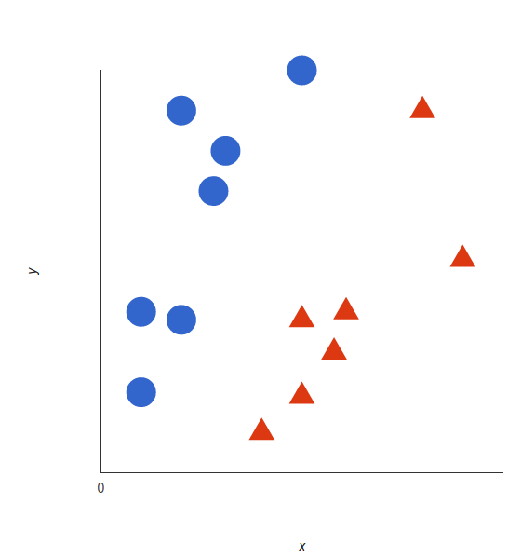

Slide 5
A support vector machine takes these data points and outputs the hyperplane (which in two dimensions it’s simply a line) that best separates the tags. This line is the decision boundary: anything that falls to one side of it we will classify as blue, and anything that falls to the other as red.

Slide 6
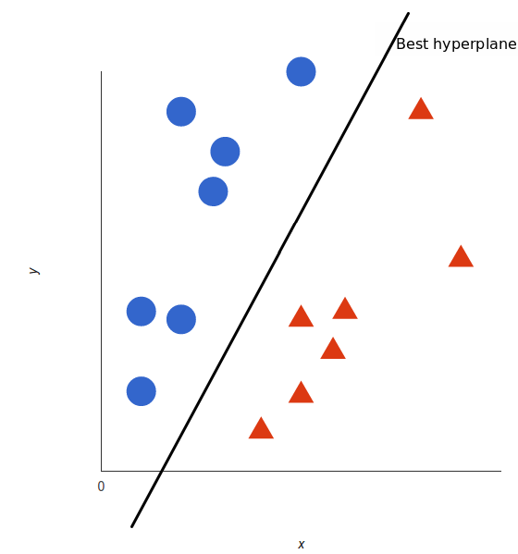

Slide 7
Hyperplanes
Hyperplanes are decision boundaries that help classify the data points. Data points falling on either side of the hyperplane can be attributed to different classes. Also, the dimension of the hyperplane depends upon the number of features. If the number of input features is 2, then the hyperplane is just a line. If the number of input features is 3, then the hyperplane becomes a two-dimensional plane. It becomes difficult to imagine when the number of features exceeds 3.
Support vectors are data points that are closer to the hyperplane and influence the position and orientation of the hyperplane. Using these support vectors, we maximize the margin of the classifier. Deleting the support vectors will change the position of the hyperplane

Slide 8
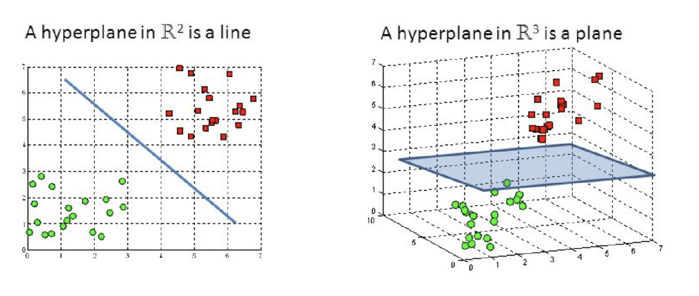

Slide 9
If we have p-dimensional space, a hyperplane is a flat subspace with dimension p-1. For example, in two-dimensional space a hyperplane is a straight line, and in three-dimensional space, a hyperplane is a two-dimensional subspace.
Imagine a knife cutting through a piece of cheese that is in cubical shape and dividing it into two parts. Then put both pieces back and observe that space in between both pieces, that is a two-dimensional subspace in a three-dimensional space. For p greater than 3, the imagination can be harder, but the intuition remains the same.
ẞ₀+ẞ₁X₁+ẞ₂X₂= 0
This is the equation of a hyperplane in a two-dimensional space. Similarly, the equation can be extended to p-dimensional setting and look like this:
ẞ₀+ẞ₁X₁+ẞ₂X₂+........+ẞ_{p}X_{p}= 0 where,
ẞ₀ is the intercept
ẞ₁ defining first axis
ẞ₂ defining second axis

Slide 10
Each beta is a parameter for one of the many dimensions we have in our space.Therefore, if we have a point X that satisfies the above equation then it means the point is on the hyperplane. In other words, if we have a point, in say 5-dimensional space, then X1 to X4 will have different value for one single point in that space and if after you put up the values in the equation above the equation ends up to be equal to zero then it means the point lies on the hyperplane.This means if the equation holds value less than zero, the point does not lies on the plain but rather below the hyperplane.
ẞ₀+ẞ₁X₁+ẞ₂X₂+........+ẞ_{p}X_{p}< 0
And, if the points lie on the upper side of the plain then the equation holds like this:
ẞ₀+ẞ₁X₁+ẞ₂X₂+........+ẞ_{p}X_{p} > 0

Slide 11
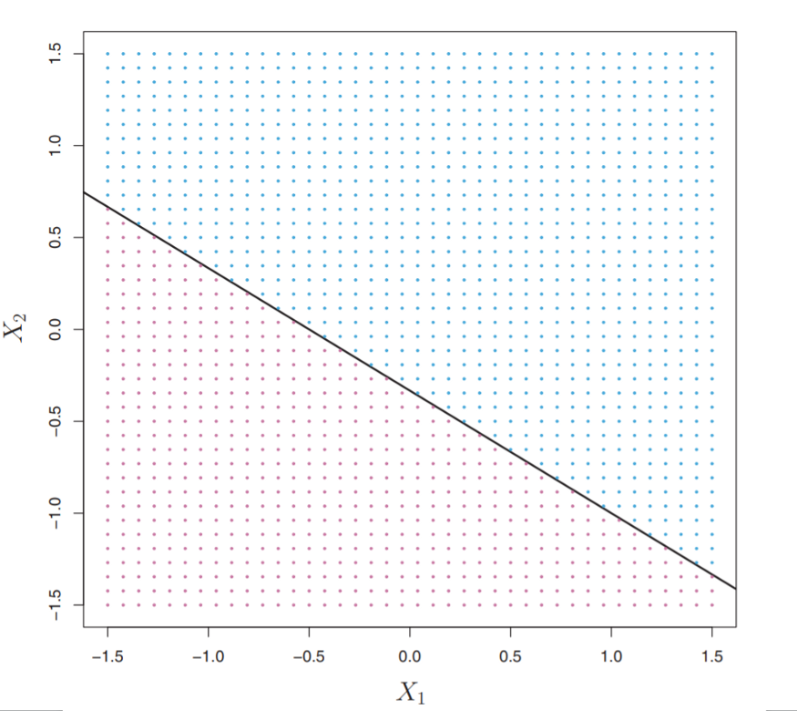
Above two equations define these two different class of dots.

Slide 12
Classification Using Separate Hyperplane
In a binary classification problem, given a linearly separable data set, the optimal separating hyperplane is the one that correctly classifies all the data while being farthest away from the data points. In this respect, it is said to be the hyperplane that maximizes the margin, defined as the distance from the hyperplane to the closest data point.
New test points are drawn according to the same distribution as the training data. Thus, if the separating hyperplane is far away from the data points, previously unseen test points will most likely fall far away from the hyperplane or in the margin. As a consequence, the larger the margin is, the less likely the points are to fall on the wrong side of the hyperplane.

Slide 13
Suppose we have one train and testing data matrix. The training data matrix have n×p dimensions. Meaning it has n observation and it is p dimensional. Each observation falls under either of the two classes, i.e. y1….yn can either be -1 or 1.
Suppose if based on the training data, we can construct a hyperplane that can perfectly separate all training observations according to classes labeled. The classifier will work like this:
ẞ₀+ẞ₁X₁+ẞ₂X₂+........+ẞ_{p}X_{p}< 0 if y = -1
ẞ₀+ẞ₁X₁+ẞ₂X₂+........+ẞ_{p}X_{p}> 0 if y=1

Slide 14
Each testing observation is assigned a classed based on which side of the hyperplane they are lying on. If an observation gives out the value of the above equation less than zero, then it belongs to -1 class and same goes for class 1.
That is, for any testing observation x(theta) we can classify it based on the sign of the equation below. If the sign is negative, then class -1 is assigned and if the sign is positive the sign 1 is assigned.
f(x∅)= ẞ₀+ẞ₁X₁+ẞ₂X₂+........+ẞ_{p}X_{p}
Also, for any particular testing observation, once we put all the values of X in the equation above and observe weather it is less than 1 or greater than 1, then the magnitude of that values determines how close or far on each side of the plain that particular observed point lies.

Slide 15
Maximal Margin Classifier
Now the problem is that if we divide data based on hyperplane, then there could be many possible hyperplanes to divide same set of numbers. How do we decide the finite number of hyperplanes to choose from?

Slide 16
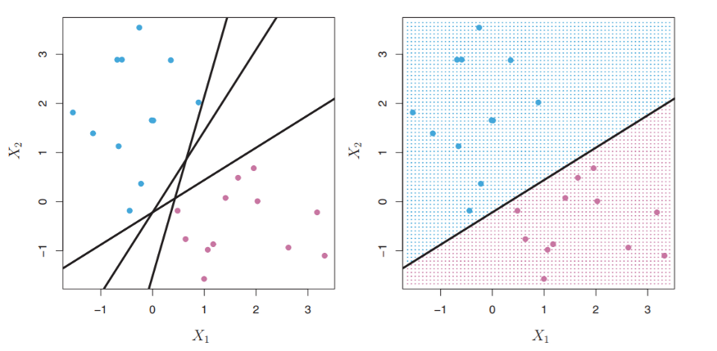

Slide 17
Solution:
Maximal margin classifier This is a classifier that is farthest from the training observations. By computing the perpendicular distance between the hyperplane to the training observations. The shortest such distance is called the minimal distance between the hyperplane and the observation, and it is called margin. Therefore, maximal margin hyperplane is the hyperplane that has the largest margin, meaning, which has the largest distance between the hyperplane and the training observations. Using that hyperplane we can classify testing data. If our model has
ẞ₀+ẞ₁+ẞ₂+.....+ẞ_{p} as coefficients
then the maximal margin classifier can classify new test observations based on the sign of
f(x∅)= ẞ₀+ẞ₁X∅₁+ẞ₂X∅₂+........+ẞ_{p}X∅_{p}

Slide 18
In simple words, for each testing observation we put all the variables in the equation above and decide which side of the hyperplane that particular observation belongs to, based on the sign of f(x).
The way maximal margin classifier looks like is that it has one plane that is cutting through the p-dimensional space and dividing it into two pieces, and then it has two lines, each on one and other side of that plane. Those lines are called margins, and the observations touching those two lines are called vectors. They are defining the length of the margin, farther those points are, farther away those two lines are from the middle hyperplane. Those touching points are called vectors because they are vectors in p-dimensional space.

Slide 19
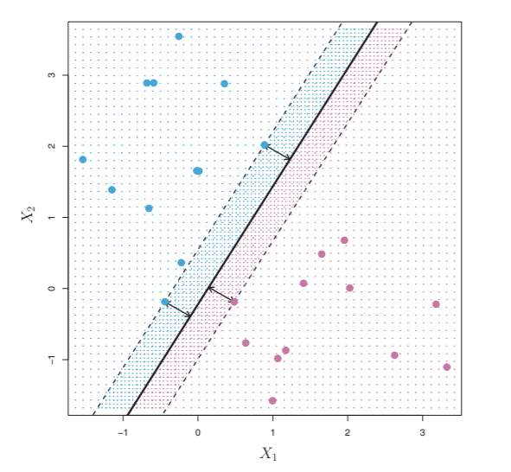
Interestingly, this classifier simply depends upon those vectors and not on all other observations available in the training set. Meaning, if you move vectors, the classifier would change its margin, but if you move all other observations the margin wouldn’t change.

Slide 20
Pros Of SVM
It works really well with clear margin of separation.
It is effective in high dimensional spaces.
It is effective in cases where number of dimensions is greater than the number of samples.
It uses a subset of training points in the decision function (called support vectors), so it is also memory efficient.

Slide 21
Cons Of SVM
It doesn’t perform well, when we have large data set because the required training time is higher.
It also doesn’t perform very well, when the data set has more noise i.e. target classes are overlapping.
SVM doesn’t directly provide probability estimates, these are calculated using an expensive five-fold cross-validation. It is related SVC method of Python scikit-learn library.

Slide 22
Applications Of SVM
Face detection
Text and hypertext categorization
Classification of images
Bioinformatics
Handwriting recognition
Protein fold and remote homology detection
Generalized predictive control(GPC)

Slide 23
THANK YOU !!!

